Slide 1
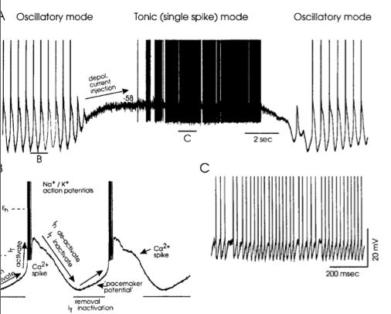
Generacja fal delta
Generacja fal delta EEG (0.5-4 Hz) polega na wzajemnym oddzialywaniu pradów I_{T} oraz I_{h} (hyperpolarization activated) w komórkach wzgórza.

Slide 2
Cwiczenie
Do komórki STN.py dodać prąd I_{h} opisany za pomocą języka NMODL.
W tym celu wykorzystać model prądu I_{h} z bazy ModelDB: https://modeldb.science/3684. Ustawić eh = -47 mV.
Dodać elektrodę IClamp (del = 700, dur = 1600, amp = -0.05).
Dostroić parametry modelu (CaT.gmax, htc.ghbar) tak, aby uzyskać generację aktywności tonicznej i salwowej w zależności od wartości podawanego prądu.
Przedstawić graficznie napięcie V, zachowanie prądu I_{T} wraz z bramkami r i s oraz prądu I_{h}, dla czasu symulacji 3000 ms.

Slide 3
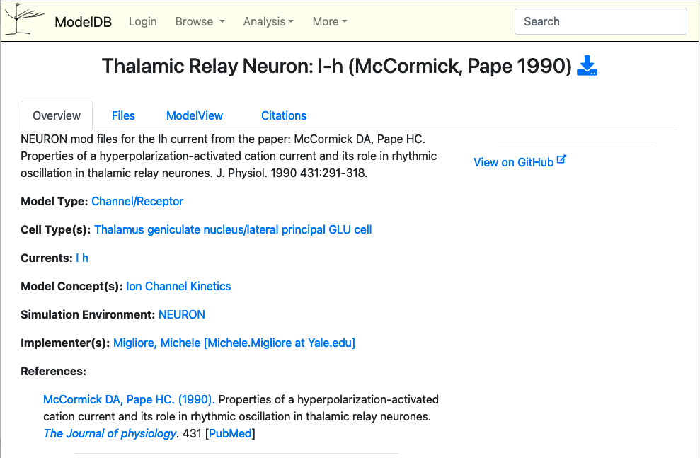

Slide 4
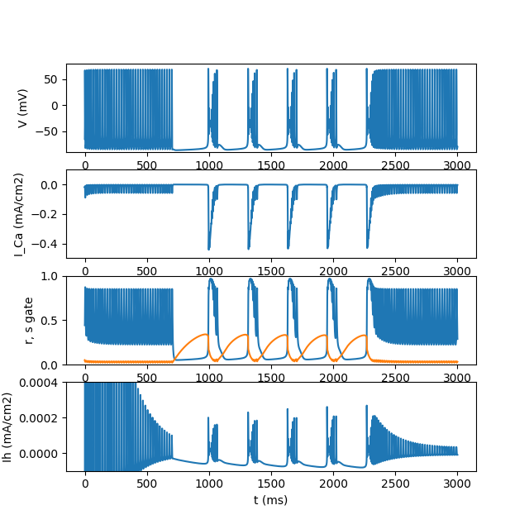
Wynik symulacji

Slide 5
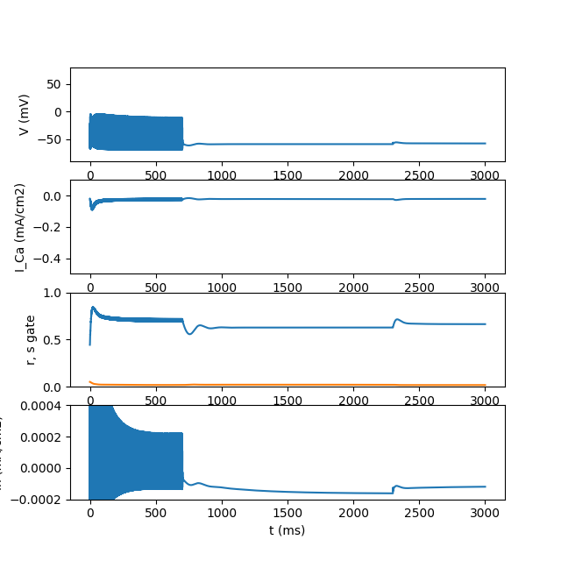
Wynik symulacji
h.celsius = 37

Slide 6
TITLE hh.mod squid sodium, potassium, and leak channels
COMMENT
This is the original Hodgkin-Huxley treatment for the set of sodium,
potassium, and leakage channels found in the squid giant axon membrane.
("A quantitative description of membrane current and its application
conduction and excitation in nerve" J.Physiol. (Lond.) 117:500-544 (1952).)
Membrane voltage is in absolute mV and has been reversed in polarity
from the original HH convention and shifted to reflect a resting potential
of -65 mV.
Remember to set celsius=6.3 (or whatever) in your HOC file.
See squid.hoc for an example of a simulation using this model.
SW Jaslove 6 March, 1992
ENDCOMMENT
UNITS {
(mA) = (milliamp)
(mV) = (millivolt)
(S) = (siemens)
}
? interface
NEURON {
SUFFIX hh
USEION na READ ena WRITE ina
USEION k READ ek WRITE ik
NONSPECIFIC_CURRENT il
RANGE gnabar, gkbar, gl, el, gna, gk
:GLOBAL minf, hinf, ninf, mtau, htau, ntau
RANGE minf, hinf, ninf, mtau, htau, ntau
THREADSAFE : assigned GLOBALs will be per thread
}
PARAMETER {
gnabar = .12 (S/cm2) <0,1e9>
gkbar = .036 (S/cm2) <0,1e9>
gl = .0003 (S/cm2) <0,1e9>
el = -54.3 (mV)
}
STATE {
m h n
}
ASSIGNED {
v (mV)
celsius (degC)
ena (mV)
ek (mV)
gna (S/cm2)
gk (S/cm2)
ina (mA/cm2)
ik (mA/cm2)
il (mA/cm2)
minf hinf ninf
mtau (ms) htau (ms) ntau (ms)
}
? currents
BREAKPOINT {
SOLVE states METHOD cnexp
gna = gnabar*m*m*m*h
ina = gna*(v - ena)
gk = gkbar*n*n*n*n
ik = gk*(v - ek)
il = gl*(v - el)
}
INITIAL {
rates(v)
m = minf
h = hinf
n = ninf
}
? states
DERIVATIVE states {
rates(v)
m' = (minf-m)/mtau
h' = (hinf-h)/htau
n' = (ninf-n)/ntau
}
:LOCAL q10
? rates
PROCEDURE rates(v(mV)) { :Computes rate and other constants at current v.
:Call once from HOC to initialize inf at resting v.
LOCAL alpha, beta, sum, q10
: TABLE minf, mtau, hinf, htau, ninf, ntau DEPEND celsius FROM -100 TO 100 WITH 200
UNITSOFF
q10 = 3^((celsius - 6.3)/10)
:"m" sodium activation system
alpha = .1 * vtrap(-(v+40),10)
beta = 4 * exp(-(v+65)/18)
sum = alpha + beta
mtau = 1/(q10*sum)
minf = alpha/sum
:"h" sodium inactivation system
alpha = .07 * exp(-(v+65)/20)
beta = 1 / (exp(-(v+35)/10) + 1)
sum = alpha + beta
htau = 1/(q10*sum)
hinf = alpha/sum
:"n" potassium activation system
alpha = .01*vtrap(-(v+55),10)
beta = .125*exp(-(v+65)/80)
sum = alpha + beta
ntau = 1/(q10*sum)
ninf = alpha/sum
}
FUNCTION vtrap(x,y) { :Traps for 0 in denominator of rate eqns.
if (fabs(x/y) < 1e-6) {
vtrap = y*(1 - x/y/2)
}else{
vtrap = x/(exp(x/y) - 1)
}
}
UNITSON
hh.mod
Poszukajmy:
/venv_neuron/lib/python3.11/site-packages/neuron/.data/share/modfile/hh.mod
TITLE hh.mod squid sodium, potassium, and leak channels
COMMENT
This is the original Hodgkin-Huxley treatment for the set of sodium,
potassium, and leakage channels found in the squid giant axon membrane.
("A quantitative description of membrane current and its application
conduction and excitation in nerve" J.Physiol. (Lond.) 117:500-544 (1952).)
Membrane voltage is in absolute mV and has been reversed in polarity
from the original HH convention and shifted to reflect a resting potential
of -65 mV.
Remember to set celsius=6.3 (or whatever) in your HOC file.
See squid.hoc for an example of a simulation using this model.
SW Jaslove 6 March, 1992
ENDCOMMENT
UNITS {
(mA) = (milliamp)
(mV) = (millivolt)
(S) = (siemens)
}
? interface
NEURON {
SUFFIX hh
USEION na READ ena WRITE ina
USEION k READ ek WRITE ik
NONSPECIFIC_CURRENT il
RANGE gnabar, gkbar, gl, el, gna, gk
:GLOBAL minf, hinf, ninf, mtau, htau, ntau
RANGE minf, hinf, ninf, mtau, htau, ntau
THREADSAFE : assigned GLOBALs will be per thread
}
PARAMETER {
gnabar = .12 (S/cm2) <0,1e9>
gkbar = .036 (S/cm2) <0,1e9>
gl = .0003 (S/cm2) <0,1e9>
el = -54.3 (mV)
}

Slide 7
hh.mod c.d.
STATE {
m h n
}
ASSIGNED {
v (mV)
celsius (degC)
ena (mV)
ek (mV)
gna (S/cm2)
gk (S/cm2)
ina (mA/cm2)
ik (mA/cm2)
il (mA/cm2)
minf hinf ninf
mtau (ms) htau (ms) ntau (ms)
}
? currents
BREAKPOINT {
SOLVE states METHOD cnexp
gna = gnabar*m*m*m*h
ina = gna*(v - ena)
gk = gkbar*n*n*n*n
ik = gk*(v - ek)
il = gl*(v - el)
}
INITIAL {
rates(v)
m = minf
h = hinf
n = ninf
}
? states
DERIVATIVE states {
rates(v)
m' = (minf-m)/mtau
h' = (hinf-h)/htau
n' = (ninf-n)/ntau
}
:LOCAL q10

Slide 8
hh.mod c.d.
? rates
PROCEDURE rates(v(mV)) { :Computes rate and other constants at current v.
:Call once from HOC to initialize inf at resting v.
LOCAL alpha, beta, sum, q10
: TABLE minf, mtau, hinf, htau, ninf, ntau DEPEND celsius FROM -100 TO 100 WITH 200
UNITSOFF
q10 = 3^((celsius - 6.3)/10)
:"m" sodium activation system
alpha = .1 * vtrap(-(v+40),10)
beta = 4 * exp(-(v+65)/18)
sum = alpha + beta
mtau = 1/(q10*sum)
minf = alpha/sum
:"h" sodium inactivation system
alpha = .07 * exp(-(v+65)/20)
beta = 1 / (exp(-(v+35)/10) + 1)
sum = alpha + beta
htau = 1/(q10*sum)
hinf = alpha/sum
:"n" potassium activation system
alpha = .01*vtrap(-(v+55),10)
beta = .125*exp(-(v+65)/80)
sum = alpha + beta
ntau = 1/(q10*sum)
ninf = alpha/sum
}
FUNCTION vtrap(x,y) { :Traps for 0 in denominator of rate eqns.
if (fabs(x/y) < 1e-6) {
vtrap = y*(1 - x/y/2)
}else{
vtrap = x/(exp(x/y) - 1)
}
}
UNITSON

Slide 9
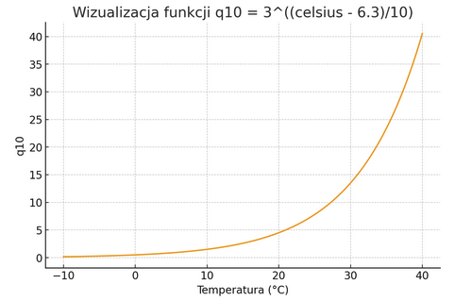
Czynnik Q₁₀
W kodzie hh.mod:
q10 = 3^((celsius - 6.3)/10)
Oznacza to, że proces przyspiesza wykładniczo z podstawą 3 i wykładnikiem rosnącym o 1 na każde +10ºC
Wizualizacja 10 = 3^((celsius - 6.3)/10)

